Slide 1
Cozying up to Literacy
Karen Borg
Director Early Childhood Division
Utah Schools for the Deaf and Blind–Blind School
karenbo@usdb.org

Slide 2
Can you remember learning to read?
Baby standing at a low bookshelf on the floor, pulling books out.

Slide 3
Reading is like a river.

Slide 4
“”
Learning to read, like learning language, begins the moment we’re born. They are immersive processes. A child learns through sensory-rich experiences what words like warm, sour, soft, and bouncy mean. It is playing on the floor with the family pets that teaches her the difference between Ruffin’s “dogness” and Fluffy’s “catness.” How does this immersion begin?
Borg,k, https://www.pathstoliteracy.org/cozying-literacy-getting-started-interaction-and-bonding/

Slide 5
So, what’s the very first literacy skill learned?
The word “love” with a print of a parent’s hand as the “o” and print of two baby’s feet as the “v.”

Slide 6
Literacy in its most basic form is the ability both to understand and to express one’s feelings, desires and experiences to others….
(Perkins Panda Resource Guide, P. 7, 2002).

Slide 7
How every child can thrive.

Slide 8
Attachment and Social Relationships
Children in warm social relationships want to communicate with others
They feel confident that when their needs are expressed they will be met
Secure attachment is based on consistent and responsive caregiving
Secure attachment gives way to exploratory behaviors
Attachment has been linked to school success years later

Slide 9
So, what’s the very first literacy skill learned?
The word “love” with a print of a parent’s hand as the “o” and print of two baby’s feet as the “v.”

Slide 10
Most important factor in very early attachment?
Eye contact!
Problem?
Mom and baby gazing into each other’s eyes.
Baby tucked under Mom’s chin–no eye contact, but enjoying the cuddle.

Slide 11
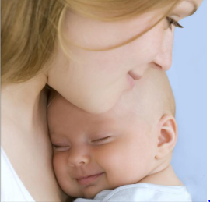
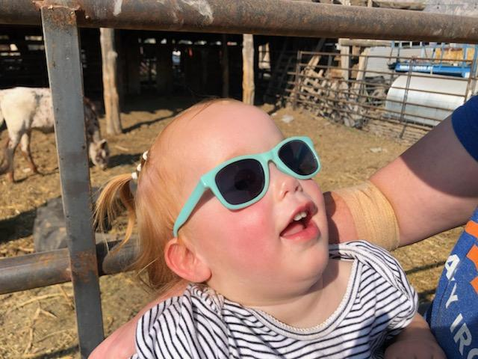
Babies Communicate in LOTS of ways
Newborn baby crying
Baby frowning and turning away from a spoonful of food
Baby with a big smile wearing sunglasses. .

Slide 14
How to Build a Dyad
ACKNOWLEDGE AND REWARD NONVERBAL COMMUNICATION
CRYING, TURNING, OTHER CUES
DEVELOP STOP AND GO GAMES
EXAMPLE: SWING BABY IN A BLANKET (OR PLAY A TICKLE GAME, ETC.) FOR 5 TO 10 SECONDS. STOP. WAIT FOR SOME SIGN FROM BABY THAT SHE’D LIKE THAT GAME TO CONTINUE. HONOR THE REQUEST. REPEAT.
NOVEL INTERACTIONS (PLAY)
STAND ON A CHAIR; TURN BABY UPSIDE DOWN; WEAR A FUNNY HAT OR GLASSES. WATCH FOR CUES IN CHILD. HONOR THE REQUEST. REPEAT.
JAN VAN DIJK ON PERKINS OR YOU TUBE

Slide 15
How to Build a Dyad
Respond verbally to the sounds and expressions your child makes.
“Talk back and forth.”
You can add information by using your language to fill in missing pieces
Think of answering “wh” questions
There’s the kitty. vs. The kitty is purring. She is happy because you are petting her back.”

Slide 16
Attachment, communication, and literacy are enhanced by using all of the baby’s senses.

Slide 17
Hearing

Slide 18
Talk to baby as you approach her
Talk to her about what’s happening (Fido is barking because there is a another dog in the yard. Did you hear the garage door? Daddy’s home!)
Sing and laugh together
Be sure people identify themselves
Identify sounds. Use other senses to explore (bells, piano, diaper package, etc.)
Allow her to make noise (spoon in metal bowl, cause and effect play, shoes with bells)

Slide 19
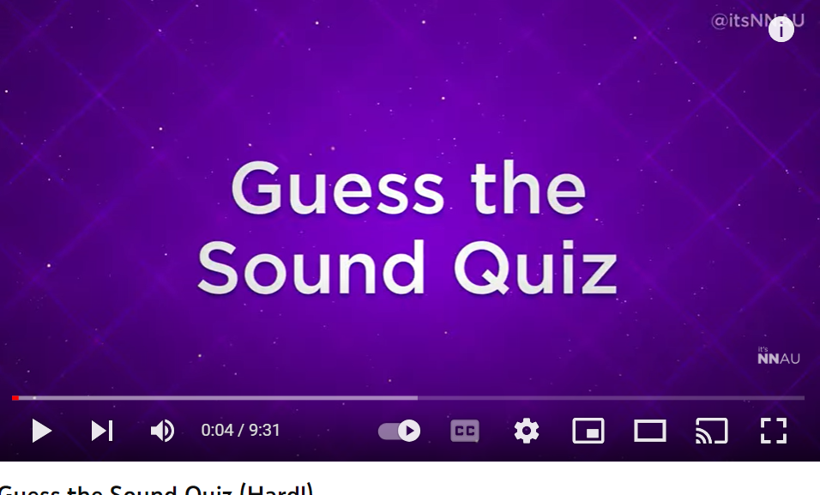
https://www.youtube.com/watch?v=jZmns3P0LoA

Slide 20
Touch

Slide 21
Develop consistent cues for actions (lift arms over head gently before picking her up, rub tummy before changing diaper)
Remember her feet might be more willing to explore textures than her hands at first. This is OK! Encourage safe exploration with her hands, face, feet and other parts of the body.
Let baby feel things before used (tissue, wash cloth, diaper, etc.) so she can learn to anticipate
Borg, K, https://www.pathstoliteracy.org/cozying-literacy-getting-started-interaction-and-bonding/

Slide 22
Smell

Slide 23
Use the same lotions, perfumes etc. so she associates smells with people
Let the baby smell (and feel) things before used on her. Use smells to build anticipation and routines.
Be sure to identify and name the smells as Baby explores.
Borg, K, https://www.pathstoliteracy.org/cozying-literacy-getting-started-interaction-and-bonding/

Slide 24
“”
Vision

Slide 25
Babies with low vision can be supported to make eye contact or look at faces when caregivers
use bright colored accessories such as hats, jewelry and eyeglasses.
Darkening eyebrows and lashes, or using a bright lipstick can help Baby find a face.

Slide 26
Concept Development: Understanding, formed through experience, that gives meaning to communication or language.

Slide 27
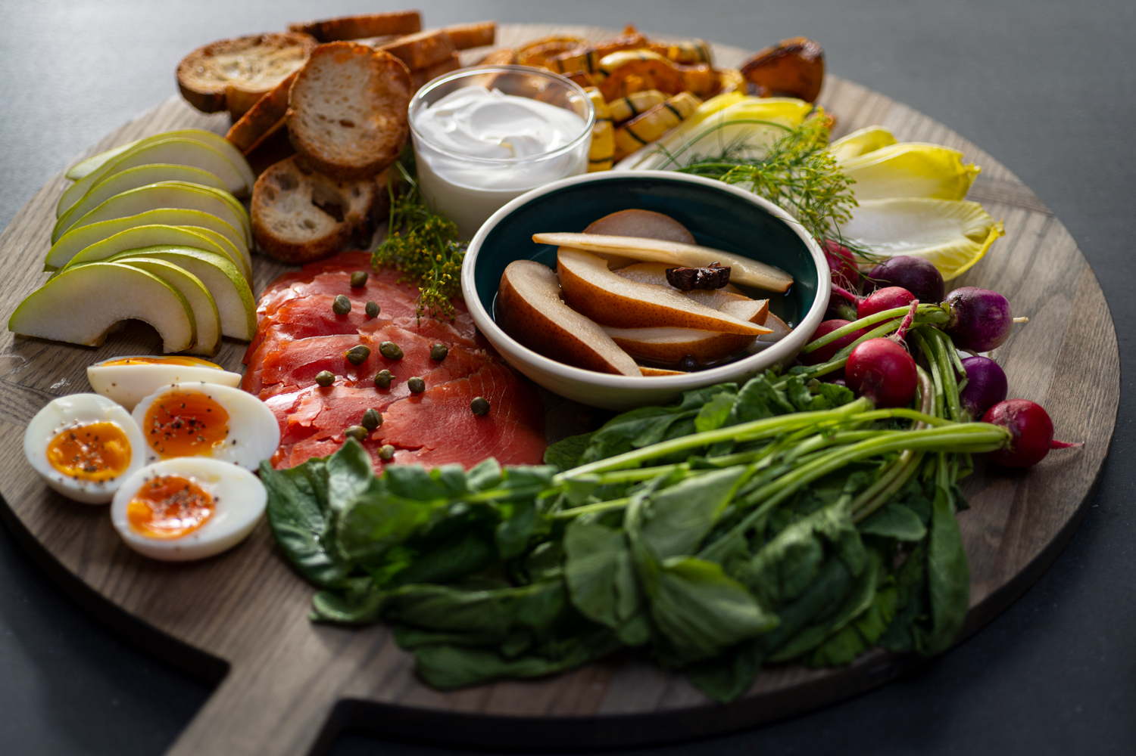
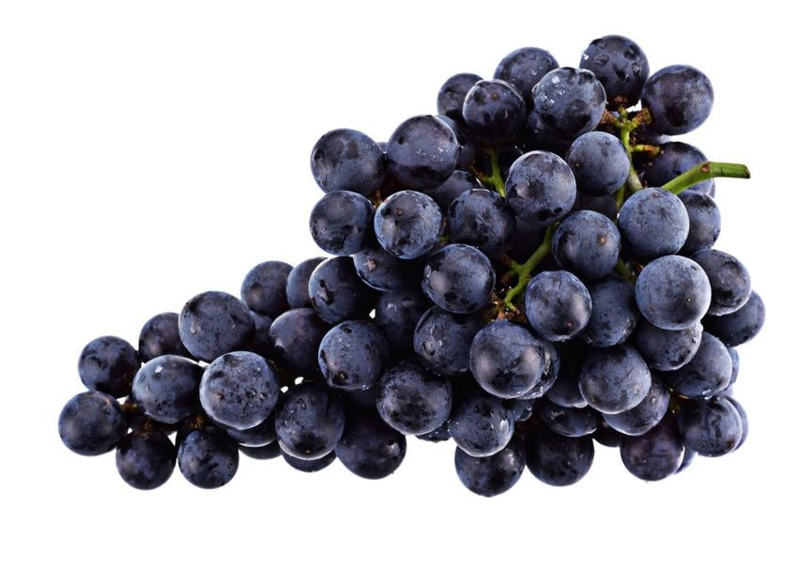
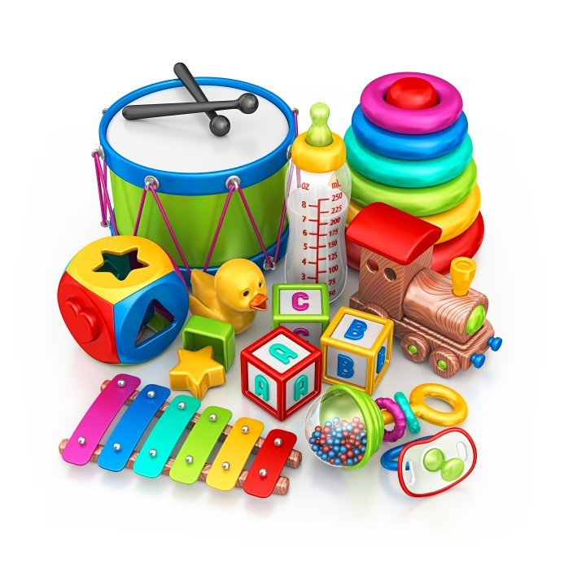
FLOTH

Slide 28
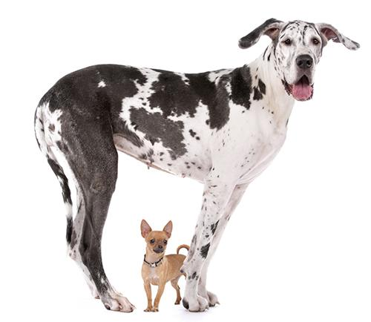
Think About the “-NESS” of an object
Think: What gives a dog it’s “dogness”?
Four legs? What else has 4 legs?
Fur? Tail? Paws?
Or is it a combination of all of these elements that through our experience we come to learn means “dog”?
So, how do we teach “-ness”? Or, how do we as practitioners break down concepts to their essential elements for young children who are blind and visually impaired?
Picture of a large, black and white great Dane with a little beige Chihuahua standing under him.

Slide 29
In order to develop understanding of various concepts, children with visual impairments must have extensive and repeated experiences with real objects” (TSBVI).
http://www.tsbvi.edu/preschool/1117-early-concept-development

Slide 30
HANDS-ON EXPERIENCE
Baby sitting in a tub with kitchen tools to play with

Slide 31
ROUTINES, ROUTINES, ROUTINES.
Cartoon drawing of a baby in a bathtub with bubbles overflowing, a showerhead raining down water, and a yellow rubber ducky sitting on the tub edge

Slide 32
Routines are vital to help young children develop concepts and skills that are the basis of literacy. By structuring activities in a clear and predictable manner, children can learn:
an understanding of objects and their functions (toothbrush, shoe)
anticipation
sequencing
cause and effect
attributes such as wet/dry; soft/hard
positional concepts such as on top/under; next to/behind
tactile skills
eye/hand or hand/hand coordination
communication skills

Slide 33
“At the most basic level, these routines should be part of the child's natural activities, including bathing, eating, dressing. The child should be actively engaged in the steps of the activity, such as helping to turn on the water for the bath, finding the towel and soap, etc. Learning to identify and gather the objects necessary for the routine helps to make the experience more meaningful. By following a predictable sequence, the child learns what will happen next and can begin to initiate the next step. As the child grows and develops, routines can be expanded.”
http://www.pathstoliteracy.org/topic/emergent-literacy/developing-routines

Slide 34
Alan Koenig and Carol Farrenkopf
“Gaining hands-on, multi-sensory experiences is not a ‘frill’ for children with visual impairments; it is a necessity.”

Slide 35
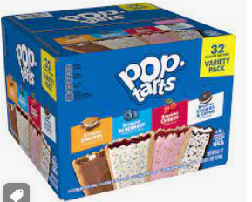
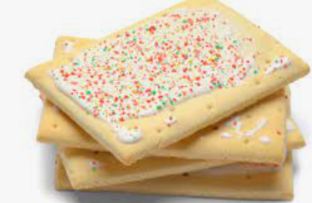
Susan is two years old and has been totally blind since birth.
Everyday Susan’s mom heats up a toaster pastry for Susan’s breakfast.
Every morning Susan hears the pastry go in the toaster oven and then hears the
bell ding when it is done.
Susan syas, “Breakfast is ready!”
Mom believes that Susan believes that Susan has a complete
Understanding of breakfast preparation.
Adapted from: http://www.wonderbaby.org/articles/everyday-activities-blind-children

Slide 36
Picture of a neon sign of a question mark

Slide 37
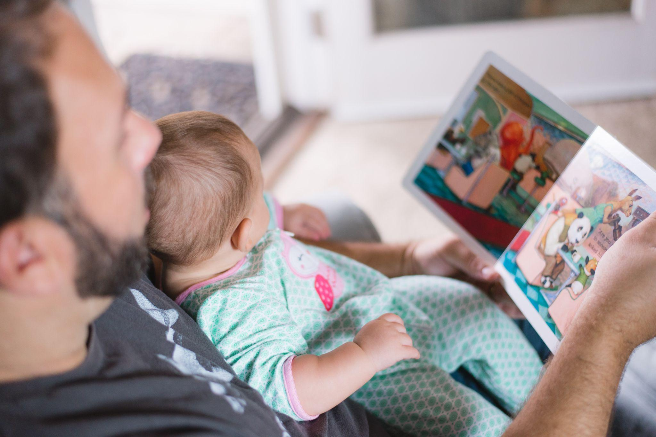
We remember the feeling long before we can remember the words
Baby sitting on Dad’s lap, looking at a book.

Slide 38
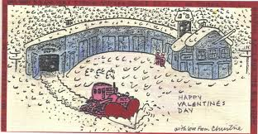
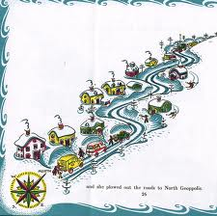
Cover and pictures from the book “Katy and the Big Snow” by Virginia Lee Burton

Slide 39
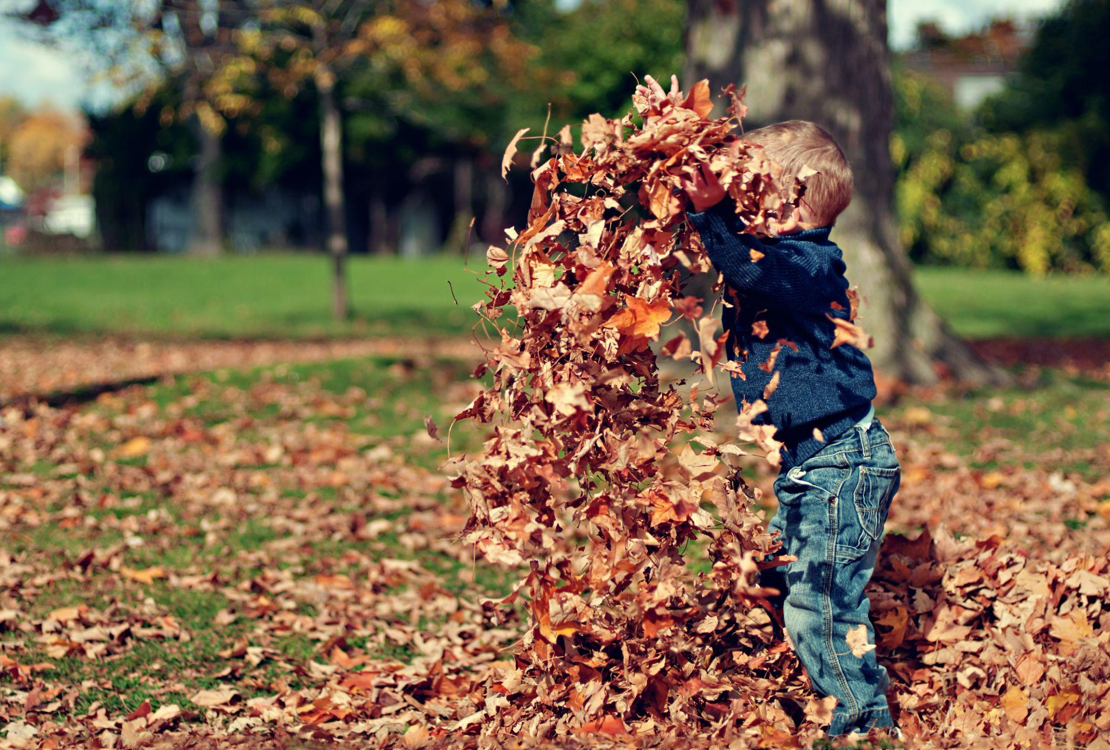
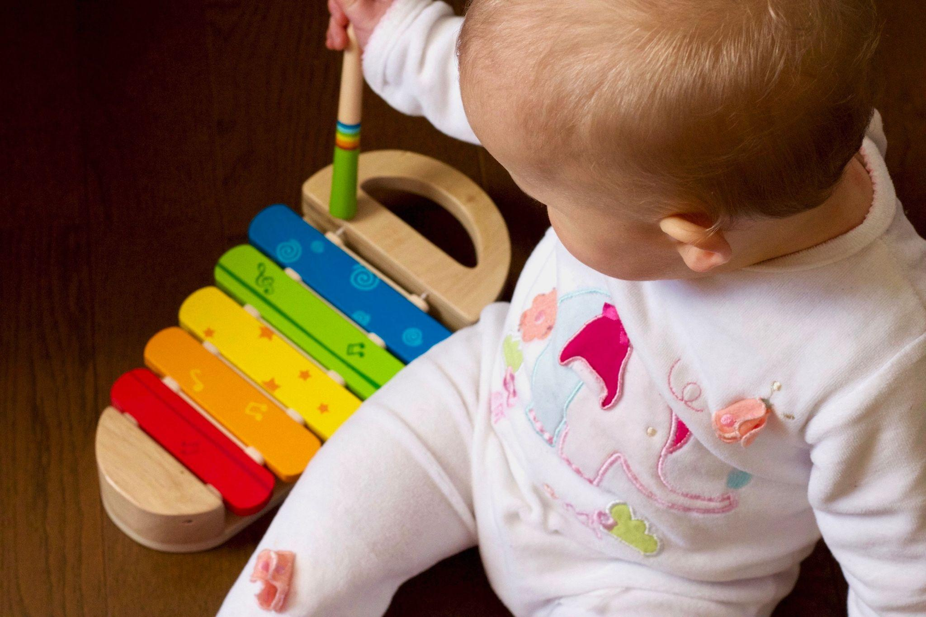
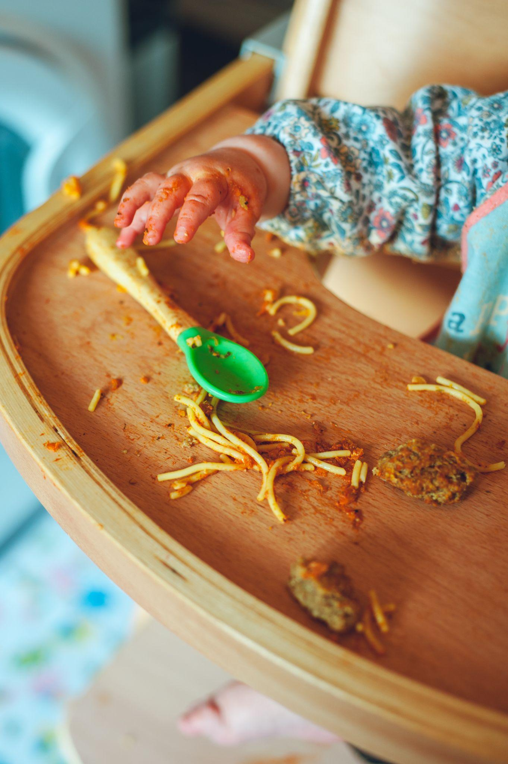
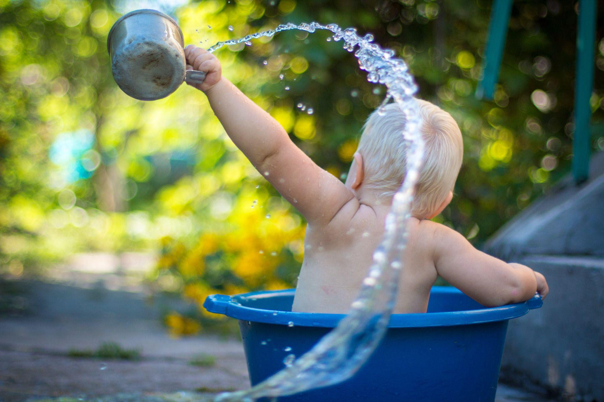
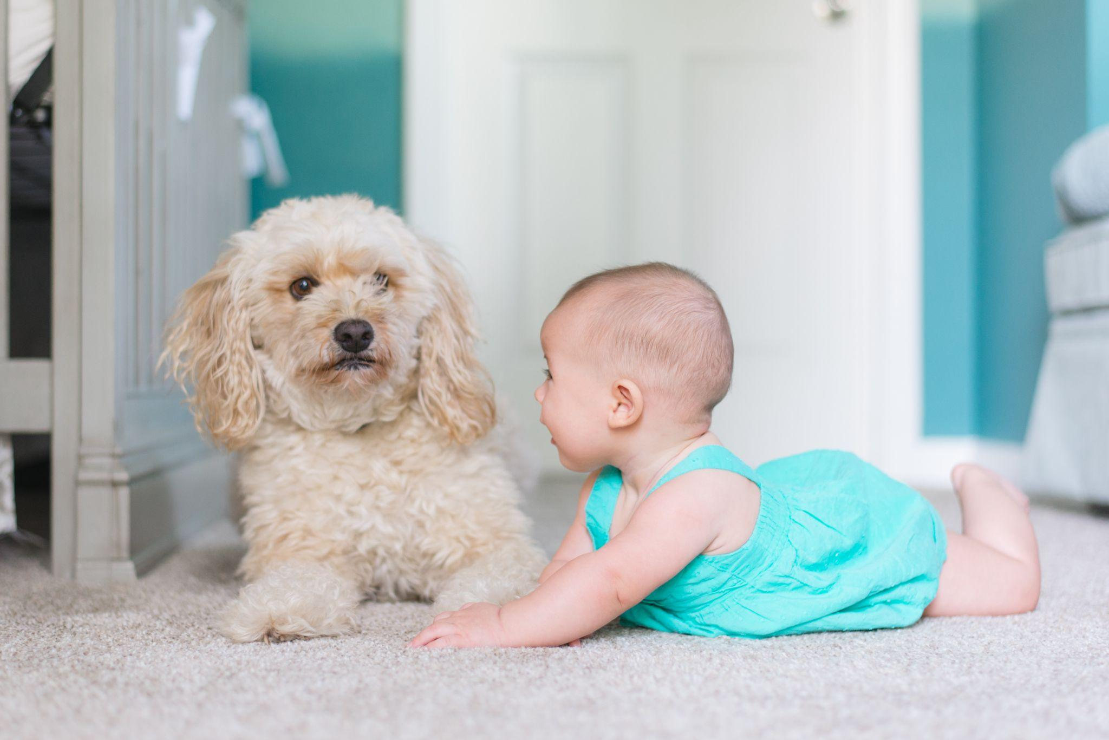
Below: Baby’s hand on a messy tray with a spoon and bits of spaghetti and meatballs
Above: toddler throwing leaves
Below: baby in a dishpan throwing water with a cup.
Above: Baby playing with a toy xylophone
Below: Baby on her tummy, holding her head up looking at a fluffy dog about 6 inches away from her face.
With just a little thought and planning, babies of all abilities can experience reciprocal communication and literacy through daily activities, meaningful interactions, and loving relationships.

Slide 40
Baby sitting in a tub with kitchen tools to play with

Slide 41
Karen Borg
karenbo@usdb.org
801.629.4748

Slide 42
REFERENCES
Borg, k https://www.pathstoliteracy.org/cozying-literacy-getting-started-interaction-and-bonding/
(Perkins Panda Resource Guide, P. 7, 2002).
https://www.ted.com/talks/molly_wright_how_every_child_can_thrive_by_five?language=en
Guess the Sound Quiz,https://www.youtube.com/watch?v=jZmns3P0LoA
http://www.tsbvi.edu/preschool/1117-early-concept-development
http://www.pathstoliteracy.org/topic/emergent-literacy/developing-routines
Koenig, A. J., & Farrenkopf, C. (1997). Essential experiences to undergird the early development of literacy. Journal of Visual Impairment & Blindness, 91(1), 14-24.
http://www.wonderbaby.org/articles/everyday-activities-blind-children
K

Slide 43
Thanks!
Do you have any questions?
youremail@freepik.com
+91 620 421 838
yourwebsite.com
Please keep this slide for attribution

