Slide 1
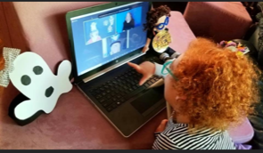
Sparkling Through Stories = Positive Impact in the States Utilizing the Storytime Show
Donna Carpenter, KY DeafBlind Project
Danna Conn, TN DeafBlind Project
Robert Hill, SC DeafBlind Project
Suzanne Dinwiddie, TN DeafBlind Project
Gwyn McCormack, Positive Eye

Slide 2
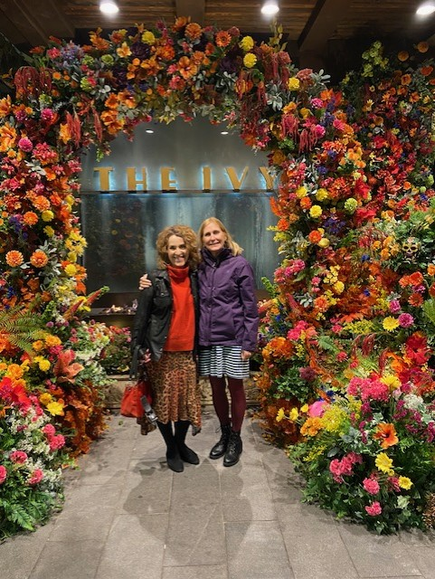
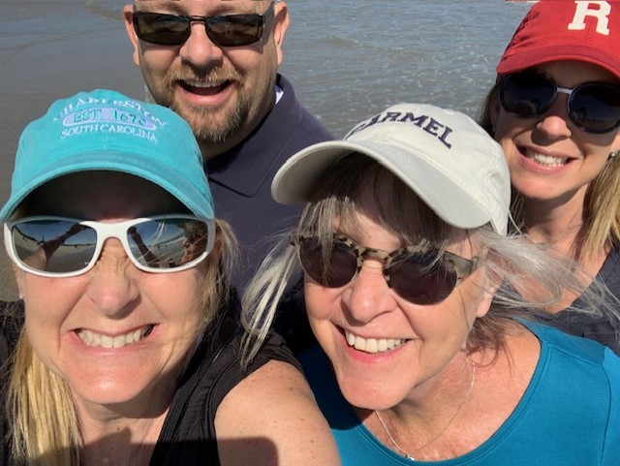
Thank YOU!
Getting In Touch With Literacy!

Slide 3
Experience working with children who are DeafBlind?

Slide 4
Outline:
Intro of DeafBlind Projects and working
DeafBlind Learners
Literacy
Covid OUTCOME - webinars
Planning and execution of Storytime
Show What Storytime looks like
Using what we have from our families and linking it
Linking Storytime to Literacy - video
Testimonials
Resources
Notes:
simulation?

Slide 5
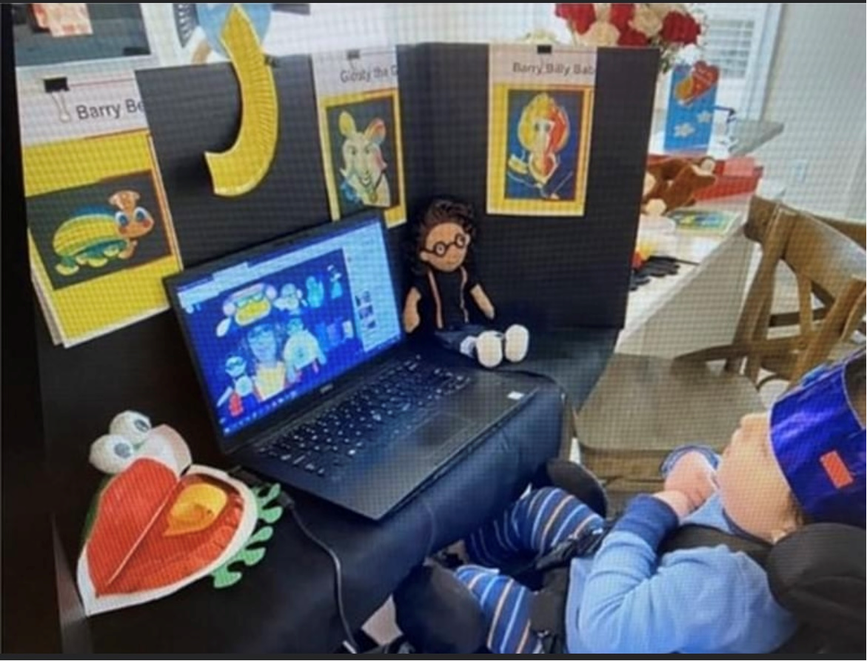
State DeafBlind Projects
Federal grant funded by the U.S. Dept. of Education, Office of Special Education Program to provides free services to families, educators, and other professionals of individuals from birth through age 21 who have combined hearing and vision loss.

Slide 6
DeafBlind Projects Provide
Individual, on-site consultations at school, home, or in the community
Resources, support and information related to dual sensory loss
Instructional strategies to address the unique communication and learning needs of each individual child
Workshops, training, conferences targeting issues related to specific deafblind areas for parents, families, and professionals
Guidance through transitional periods: early childhood transitions to school; transition from one classroom or school to another; and transition into adulthood
Opportunities for families and professionals to network
Child Find and maintain a state census of individuals birth through age 21 with combined hearing and vision loss

Slide 7
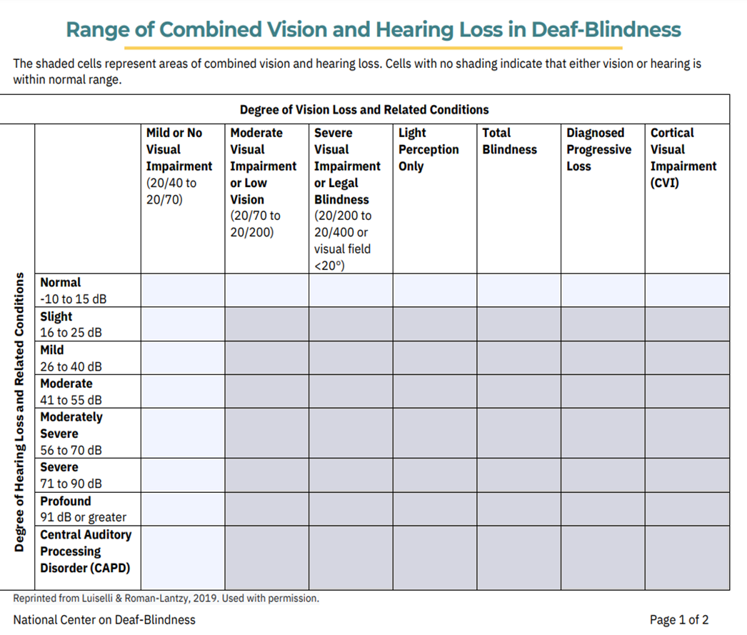

Slide 8
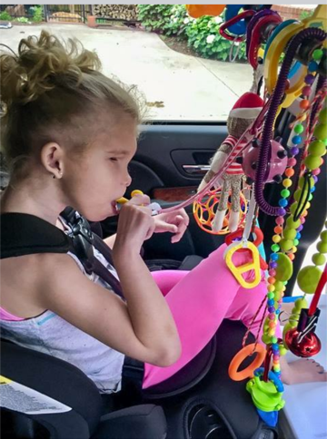
Diversity in DeafBlindness (DB)
Extremely low incidence disability
90% of individuals with DB have 2 or more other disabilities
Approximately 11,000 children and youth with DB in the United States.
Notes:
DB count in Iceland, Finland etc,.... who would like to share?

Slide 9
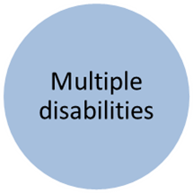
Terminology
Dual Sensory Loss
Combined Vision and hearing loss
DeafBlindness
Complex learning needs
Co-Occurring
Sensory
Loss
Deaf/HH
Plus

Slide 10
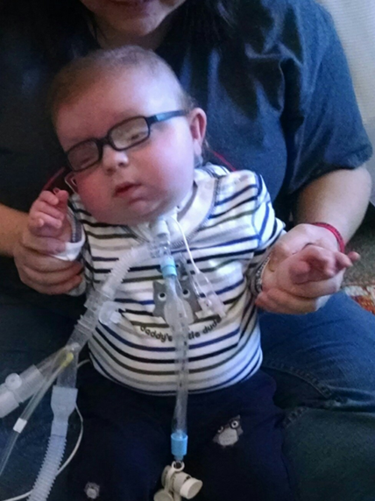
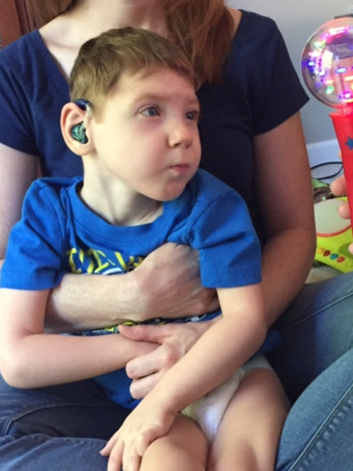
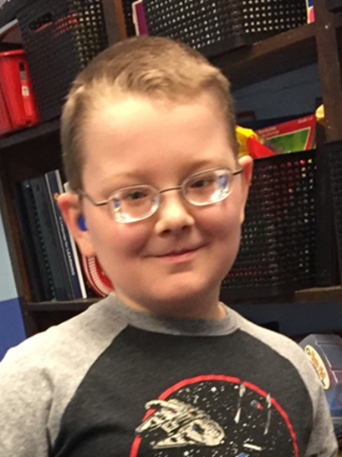
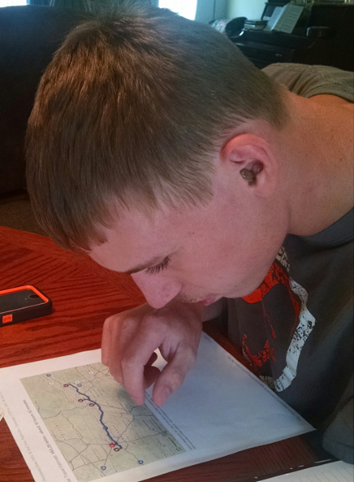
Let’s look at the most common reasons for combined hearing and vision concerns

Slide 11
Leading causes of DeafBlindness
Prenatal/Congenital Complications
Cytomegalovirus (CMV)
Hypoxic ischemic encephalopathy (HIE)
Microcephaly
Hydrocephaly
Maternal Drug use
Periventricular leukomalacia (PVL)
Complications of Prematurity
Postnatal Non-Congenital
Asphyxia
Meningitis
Severe Head Injury
Tumors
Encephalitis
Cerebral vascular accident
Intraventricular hemorrhage

Slide 12
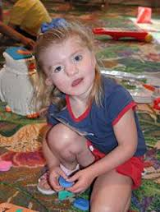
Genetic and Heredity Causes of DeafBlindness
CHARGE Syndrome
Usher Syndrome
Sticklers Syndrome
Down Syndrome
Dandy-Walker
Cornelia de Lange Syndrome
Goldenhar Syndrome
Notes:
HEARING: up to 75% some level of altered hearing status in at least one ear
VISION: 50-60% have myopia/nearsighted, strabismus/misaligned eyes, or cataracts

Slide 13
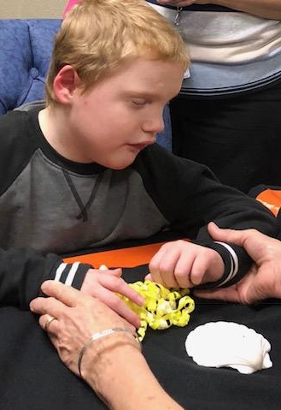
Any information or intervention presented outside a child’s visual range, without regard to auditory skill level, their personal interests, or sensory system needs is ineffective.
Notes:
Hearing and vision are the only “distant” senses
All concepts begin with relations
Modalities

Slide 14
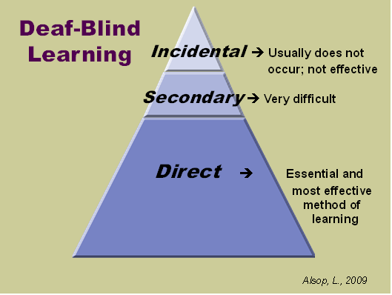

Slide 15
Learning “Bubble”
Distance Senses
Access to environments, people, information, activities, fun, friends, relationships, touch
Incidental Information
Notes:
grocery store

Slide 16
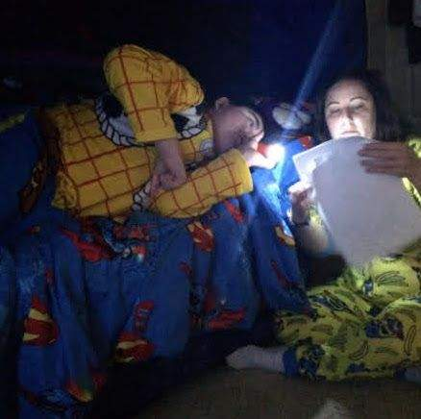
Notes:
entering the bubble

Slide 17
Evidence Based Practices
Building Trusting Relationships
Child Guided Approaches, Active Learning, and Shared Experiences
Appropriate Hand Use and Respectful Touch
Identifying Appropriate Communication Modalities
Preparing the Learning Environment
Predictable Routines & Cues

Slide 18
Literacy
Literacy has commonly been defined as the ability to read and write. However, that definition has placed literacy beyond the scope of possibility for individuals who have complex sensory, physical or developmental differences
literacy.nationaldb.org

Slide 19
Broaden child’s world beyond “self”
Perspective taking
Enjoyment
Story telling
Choices
Fun
Is not a straight line of instruction
Time to explore, manipulate
SLOW DOWN
Notes:
Add picture of storytime materials

Slide 20
Pivoting During Covid
https://www.youtube.com/channel/UCVp_IjIiIGv4IysiWMzpVTw/videos
Over 12,000 registrants, USA and Worldwide
Families and professionals
Provided over 60 trainings
Collaborations were essential!

Slide 21
Planning and Execution of Storytime

Slide 22
The State DeafBlind Projects collaborated to create an online space for families to enjoy stories, build confidence, and create a home library that is inclusive of all family members. State DeafBlind Projects were purposeful in their planning to send craft activity boxes to all family participants, contract with Gwyn McCormack, provide American Sign Language Interpreters, captioning, and translating into Spanish. The Storytime Show connects to the Positive Looking Program strategies to ensure active participation for children who are Blind/visually impaired, DeafBlind, Complex Learners.

Slide 23
Unexpected Outcomes and OPPORTUNITIES
Attracted kids with the most complex learning needs
Students of all ages - individualized needs and strengths
Connection with Siblings
Built caregiver/parent confidence
Set up environments to help child access literacy
Expanded “bubble”
Notes:
Moved the child’s “bubble”. Family involvement

Slide 24
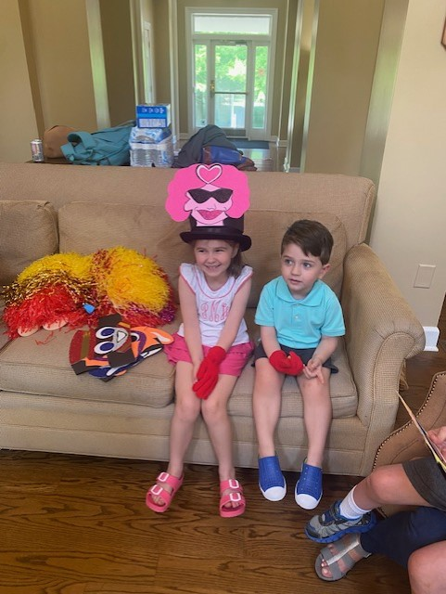
Notes:
Siblings and family experience - packets of materials

Slide 25
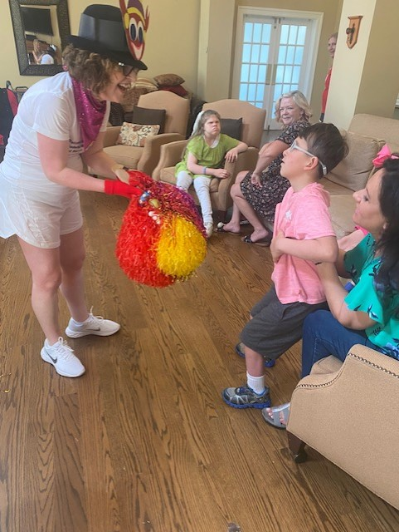

Slide 26
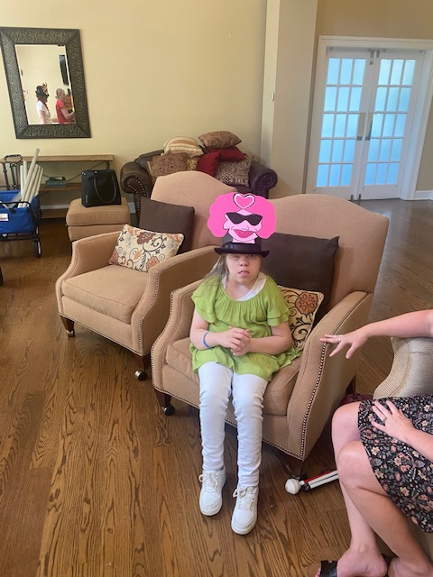

Slide 27
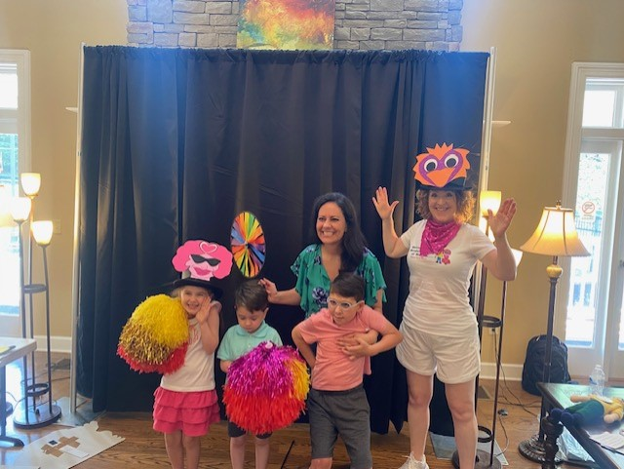

Slide 28
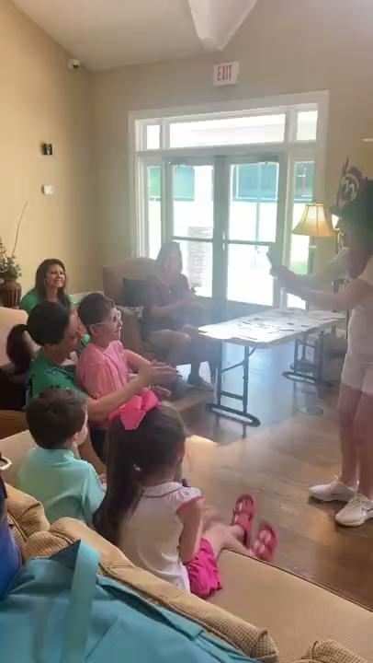

Slide 29
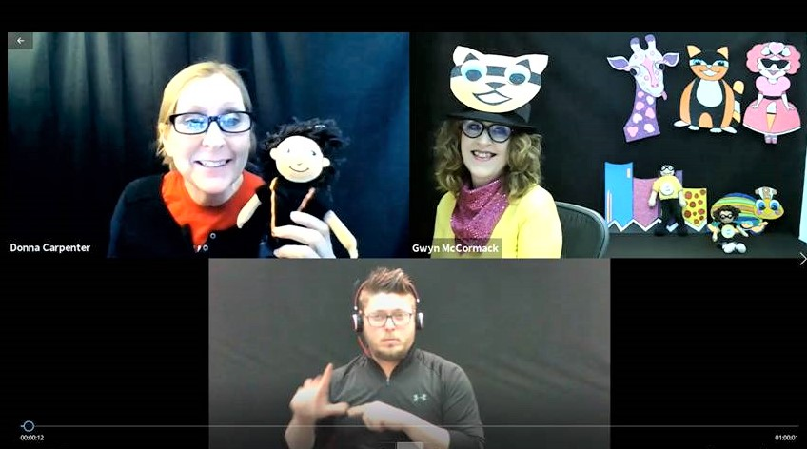
Collaboration with Deafblind Projects across 22 US States
Donna introducing the Story Time Show she is holding Marvin. Gwynnie-Gwyn-Gwyn is wearing a Cat Hat and waiting to go LIVE, Bryan is interpreting the show Donna introducing the Story Time Show she is holding Marvin. Gwynnie-Gwyn-Gwyn is wearing a Cat Hat and waiting to go LIVE, Bryan is interpreting the show
Notes:
unexpected outcomes

Slide 30
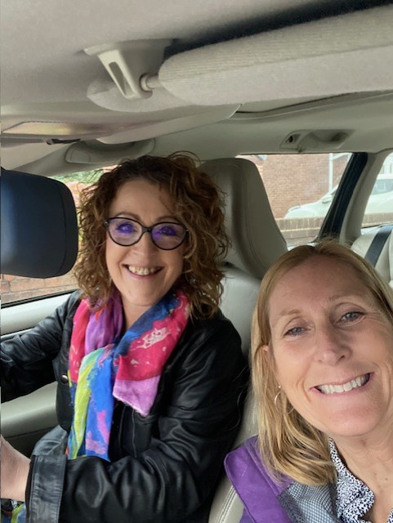
Meet with Gwyn to plan for the new story
Notes:
We met across the ocean to understand the new story, plan for all parts

Slide 31
What Needs to Get Done BEFORE?
GWYN
Send out story
prepare craft info
prepare character info
set up FB page
DeafBlind Projects
send out registrations
prepare any braille
create craft boxes
Marvin dolls
schedule ASL and Spanish interpreters
Captioning
Notes:
Zoom - met with them

Slide 32
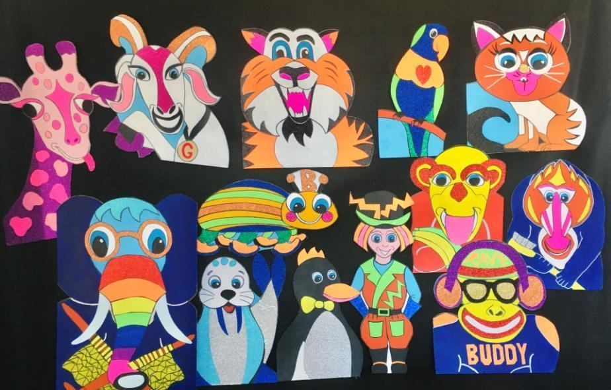
Notes:
REGISTRATION

Slide 33
What do I need to know?
When? | Thursdays, February 4th, 11th, 18th, 25, 2021 4pm Eastern Time. 3pm Central Time
Where? | On ZOOM
Who can join? | Any family who has a child on their state’s DeafBlind Project Any age!
Who will lead Story Time? | Gwyn McCormack from the United Kingdom is a teacher of vision impairments and the Sparkly Box of Stories Story Teller. There are lots of free resources on Gwyn’s site: https://www.positiveeye.co.uk/
What Story? | Story Time will follow the book, ‘Marvin and the Rainbow Children’s Zoo Adventure’ by Gwyn McCormack
COST? | FREE
How do I join? | Register at this link for all 4 sessions: REGISTER HERE
What to Expect? | You and your child will receive a Sparkly Box full of materials for participating in Story Time and creating arts and crafts to follow the story.
Questions? | Contact your DeafBlind Project:
Notes:
sent out the invitation to our families - multiple DeafBlind Projects

Slide 34
Notes:
stop looking at it through our eyes and perspectives - allow the child to decide - give them opportunities

Slide 35
What to do for follow-up?
GWYN
Debrief after show
FB follow-up
connect with parents
prepare for next show
DB PROJECT
Debrief after show
create shareable link for Story Time
Evaluation

Slide 36
Story Time
Positive Looking Visual Skills
LIteracy for DB Learners
The Story Time Show | Positive Looking Visual Skills | Literacy Checklist for Learners who are DeafBlind | Best Practice when working with Learners who are DeafBlind

Slide 37
The Story Time Show | Positive Looking Visual Skills | Literacy Checklist for Learners who are DeafBlind | Best Practice when working with Learners who are DeafBlind
 | visual awareness visual attention localization fixation tracking transfer gaze scanning visually directed reaching visual discrimination and recognize of objects visual discrimination and recognize of images and details in pictures identification and perception of patterns, numbers, and words | attends engages beginning/middle/end anticipates characters settings creates models rhythm recognizes FUN vocabulary building repetition | building a trusting relationship child guided/active learning/shared experience HUH common modalities prepared environment/predictable

Slide 38
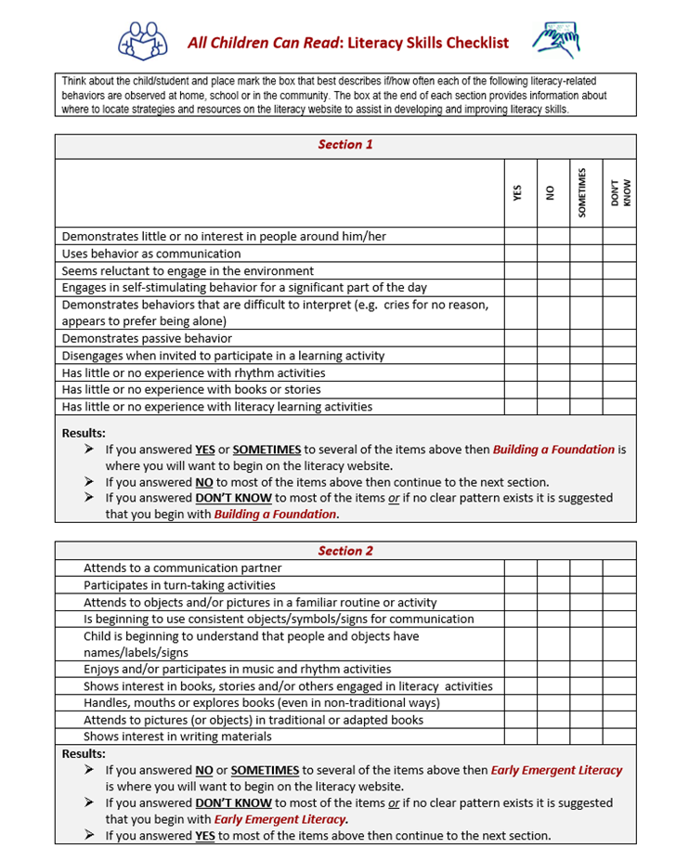

Slide 39
Let’s LOOK at Story Time Show?
I wear glittery hats, a high contrast tee shirt and neckerchief.
Gwynnie-Gwyn-Gwyn wearing Crazy Crab Craig hat and holding Marvin

Slide 40
THE START
Gwyn - says hello and introduces herself
This signals the START of storytime
It is repetitive
It is sing songy
It introduces Gwyny Gwyn Gwyn
*woodland 4:06-44

Slide 41
Name Roll
Hello Bella
Kids get exciting about their names being called
attention
Engaging
attending to the story (showing an interest)
Auditory and visual discrimination
Woodland: 5:10- 7:36

Slide 42
rainbow spin
11:17 - 12:30
countdown -numeracy
anticipation
visual skills

Slide 43
intro to the main character
Familiarity with the main character
Specific Voice
Common in all stories
Routine
Anticipation
Building Confidence
Marvin
12:48

Slide 44
song
lovely songs by Tomity Tom
songs become familiar
19:53

Slide 45
Intro to other characters
Can be other characters in a story
They interact with each other
They look and sound different
Compare/contrast
20:55

Slide 46
Craft time on the show
Families would receive a Sparkly Box full of materials for participating in Story Time and creating arts and crafts to follow the story.

Slide 47
craft
time to “remember” the story
model building to connect
fun as a family
can revisit at another time
39:03

Slide 48
How are literacy outcomes strengthened?
Concept development
Fine motor
Tactile discrimination skills
Auditory and language development
Visual skills (Visual attention, tracking, scanning etc)
Book and story skills

Slide 49
Strengthens literacy outcomes
The Outcomes have quite literally surprised everyone. The class team of this girl thought she was not able to engage in online learning. The parent was able to share with the school and it supported hem to include the strategies in the literacy curriculum. Mirande watching the show with great focus
Notes:
beginning, middle and end. Brought story to school, engaged peers – built parent confidence, has since spoken at conferences

Slide 50
The Story Time Show strengthens Literacy Outcomes
The Outcomes have quite literally surprised everyone. This little boy will watch the show for an hour , engaging and participating. In fact he cries when it is over. James watching the show surrounded by characters and crafts.
Notes:
Suzanne home visit - trying to imitate Gwyn

Slide 51
A family watching the Story Time Show
Can you imagine the joy for a family of participating in a virtual Story Time Show inclusively of their child with complex learning needs…with success! A little girl watches the Story Time Show with her mom.

Slide 52
The show’s interpreters. American Sign Language, Spanish and Captioning
Bob signing the show,
Notes:
lots of coordinator to ensure accessibility for all

Slide 53
Mid show chat with Marvin
Children respond warmly to Marvin’s mid-show chat, a moment enhanced by each having their own Marvin doll to interact with. Gwynnie-Gwyn-Gwyn looking at Marvin.

Slide 54
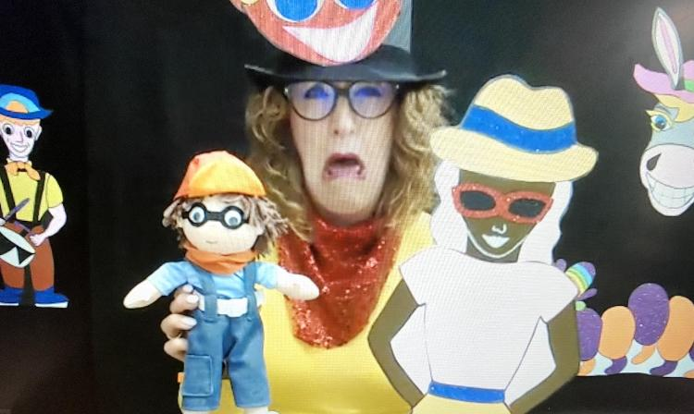
Enthusiastic story telling
Highly energetic, enthusiastic storytelling, ‘shout-outs, rhythms and funny voices all combine to maintain the children’s focus and attention. Gwynnie-Gwyn-Gwyn holds Marvin and Arabella and she has a funny face

Slide 55
Simple black background and high contrast characters
High contrast, glittery cardboard characters enact Marvin’s adventures. I interact with the characters in the screen. Gwynnie-Gwyn-Gwyn holding glittery character Beautiful Betty Bird and Marvin

Slide 56
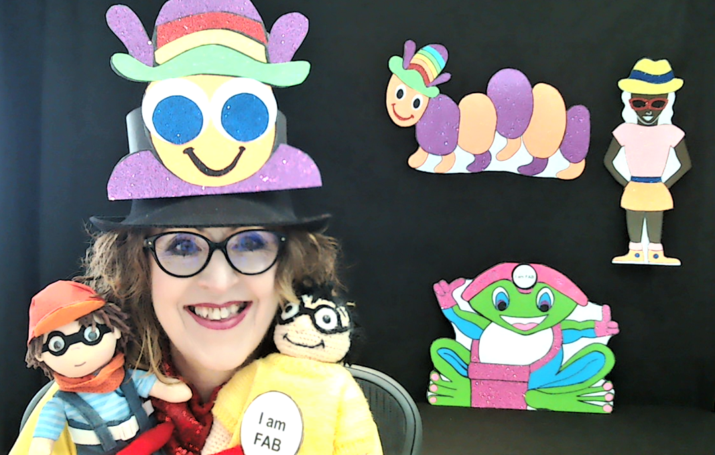
A doll that represents Marvin
I use a doll that represents Marvin, the children all have one too.
Gwynnie-Gwyn-Gwyn holding Big Marvin and Little Marvin

Slide 57
Spinning Rainbow Wheel
Rainbow wheel welcome to draw the children in. Gwynnie-Gwyn-Gwyn holding the rainbow wheel

Slide 58
Pom-pom gloves
Gwynnie-Gwyn-Gwyn gives individual name call outs.
Gwynnie-Gwyn-Gwyn wearing red gloves with yellow pompoms

Slide 59
Cheerleader pompoms
High contrast pompoms used to engage. Gwynnie-Gwyn-Gwyn holding big cheerleader pompoms in different colors
Notes:
tactile items included in the box - child becomes an active participants

Slide 60
OSEP Conference SEN Leaders Conference
https://youtu.be/mj5Uu9HNPjI
Starts at 16:30
Notes:
16:30

Slide 61
Testimonials

Slide 62
What do the Parents say…..
“My child is taking part in stories with greater concentration,
she is now asking questions and is engaged,
The teacher said to mom…I don’t understand the change
Mom answered, ‘why she is watching Miss Gwynnie-Gwyn-
Gwyn’s story time show”
“Story Time has helped her to start paying more attention to
stories being read in class. She shows so much more
interest in stories than she did before we started story time
with you.”
“My daughter engages in a new and different way. Her attention and
focus is improving and she is more vocal”

Slide 63
Jade’s mom said, “Jade loved this week’s craft and video”
Jade is smiling and holding Marvin and she has Beautiful Betty Bird on her tray

Slide 64
Miss Gwen is so enthusiastic that our sweet girl lifted her head to watch. This takes a lot of work for her so we know she must have enjoyed it!!! Can’t wait for next week
Jade watching the show holding her Marvin doll

Slide 65
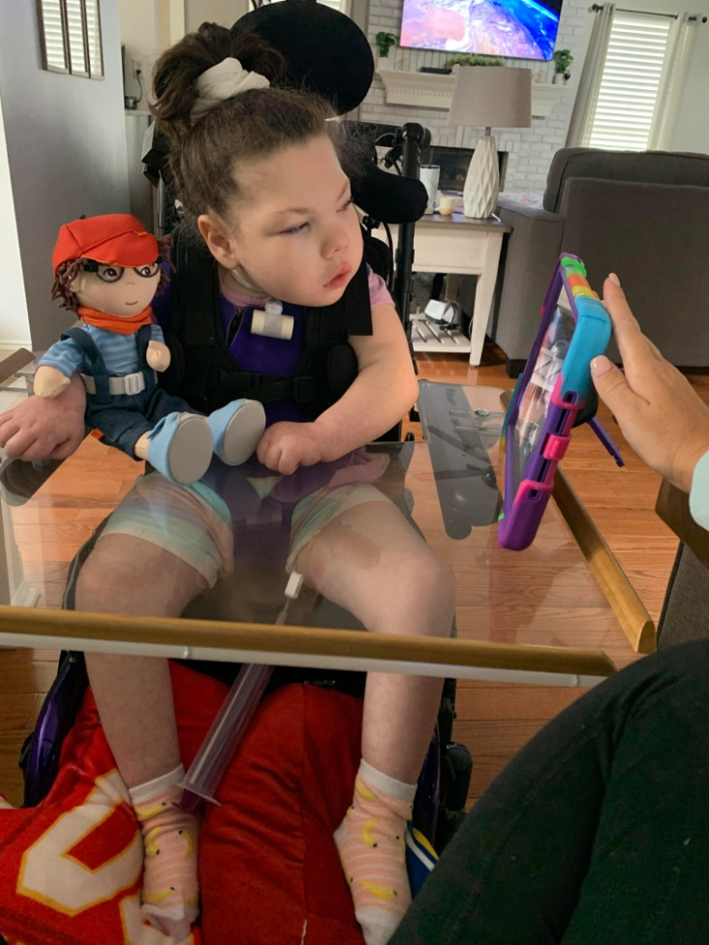
This girl loves her some Gwen and Marvin!!!! Every time Gwyn comes on she looks right at the screen! What a blessing to have something that Jade reacts to on her own!!!! Big moves for this strong little girl!!!”
Jade watching the show holding her Marvin doll

Slide 66
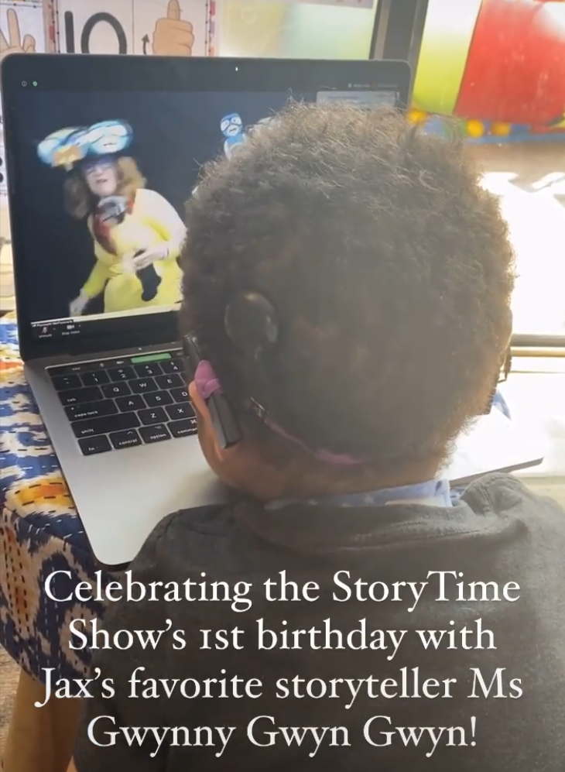
Mom of Jaxon: “Thank you for creating this beautiful story time for our kids!”
Jaxon resting his chin on the laptop to watch the who
Text reads: Celebrating the Story Time Show 1st birthday with Jax’s favorite storyteller Ms Gwynny Gwyn Gwyn!

Slide 67
Mom of Jaxon: “Thank you for creating this beautiful story time for our kids!”
He hasn’t let go of his Marvin doll and he has been engaged in pretend play, clapping hands and trying to make him dance and walk. It’s been amazing to watch especially as this was one of our long term goals
Your story time adds so much to our home education programme it engages him, he claps and smiles, laughs and he is glued to the screen. He doesn’t react that way to any other show or session we attend on Zoom

Slide 68
“Asher truly reacts differently to the show It grounds her as well……”
Asher watches the show and traces around the characters

Slide 69
Michelle, Asher’s Mom
.
I love seeing how excited she is!’
‘It’s so much better in person. She yells and you can see every
muscle engage right down to her toes’
Asher truly reacts differently to the show. It grounds her as well.
She was having a difficult time due to tooth pain and none of her
norms were working. So I asked her if she wanted to watch
Gwynnie-Gwyn-Gwyn’s Story Time Show. Her tears stopped and
she became excited. The rainbow spin in particular that visual
stimulation delivers every time.

Slide 70
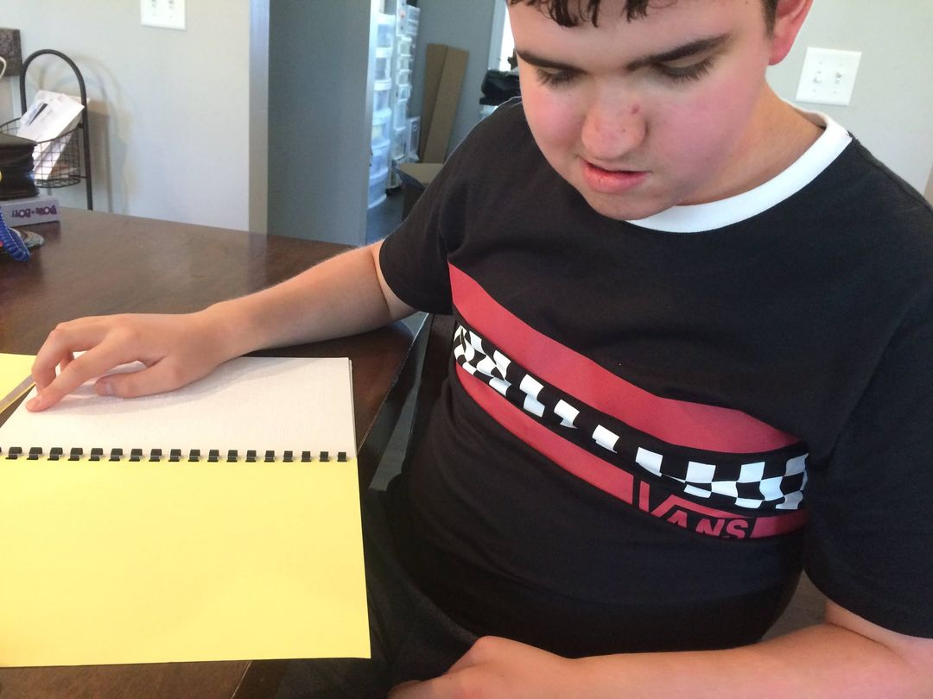
Liam reads story in braille ahead of the show!
Liam enjoying listening to the show while reading/signing along in his book! His mom said, “Liam is loving it! Liam absolutely loves the Marvin stories, characters and music!”

Slide 71
Video of Liam
In this video of Liam, watch as he enjoys dancing to the Ribbet song
He requested to listen to this video!
https://drive.google.com/file/d/1lxd32AUll7Qvq6mXeAMfKKngPD4SPA8s/view
IMG_3052.MOV

Slide 72
Karonica, Mom of Delilah
My child is taking part in stories in school with greater
concentration and interest. She is now ASKING
QUESTIONS and engaged. The teacher said to Mom, ‘I
don’t understand the change….’
Mom replied…..
‘Why she is watching Miss Gwynnie-Gwyn-Gwyn’s Story
Time Show

Slide 73
AH-HA Moments???

Slide 74
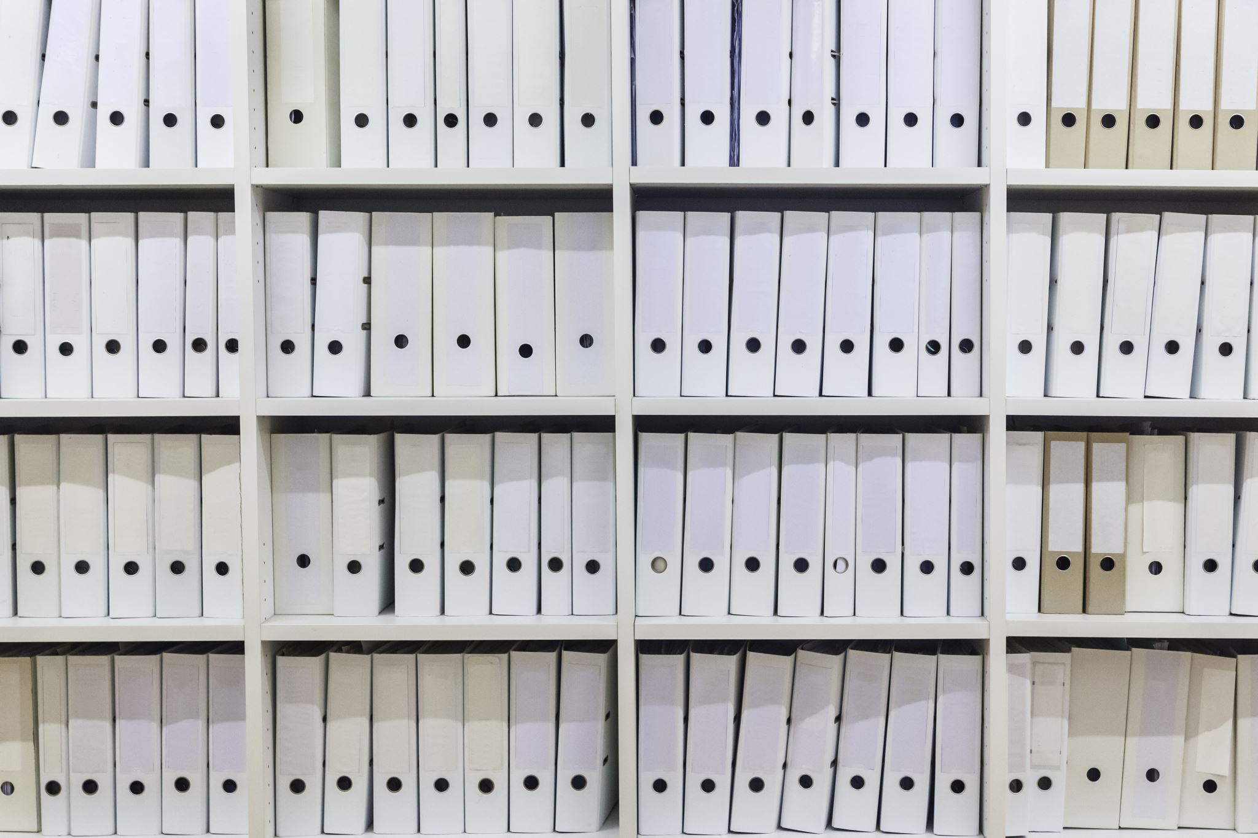
RESOURCES

Slide 75
Literacy for Children with Combined Vision and Hearing Loss
https://www.nationaldb.org/products/literacy-for-children-combined-vision-hearing-loss/
National Center on DeafBlindness - Practice Guides
https://www.nationaldb.org/info-center/professional-development/practice-guides/
Teaching Children Who are Deafblind: Professional Development for Educators
https://www.nationaldb.org/national-initiatives/iqp/professional-development-modules/
Literacy Checklist
https://www.nationaldb.org/media/doc/Literacy_Skills_Checklist_English.pdf

